Slide 1
REAL ESTATE MARKET ANALYSIS PROJECT
Yu Lu

Slide 2
REAL ESTATE MARKET ANALYSIS
Data Scraping
API
Data Cleaning Up
Visualization
Analysis

Slide 3
DATA SCRAPING

Slide 4
DATA SCRAPING
Send a search request on Redfin.com and pull the recently sold properties limited to single family home, townhouse, condo and multifamily home in Fremont, CA
Scrap on the response for the property address, sold date
Navigate to each property page and scrape other data such as the following:
Sold price
Sold date
Number of bedroom
Number of bathroom
Size of the property
Lot size
HOA
Year build
Property type

Slide 5
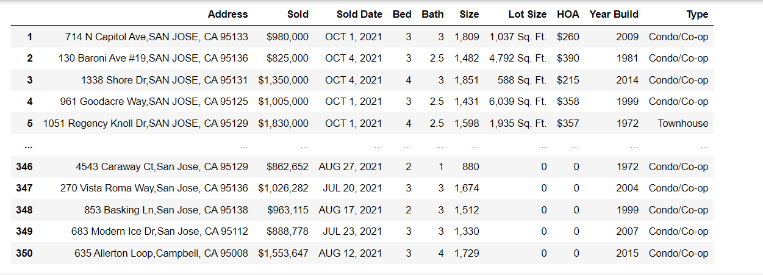
Sample output of the dataframe

Slide 6
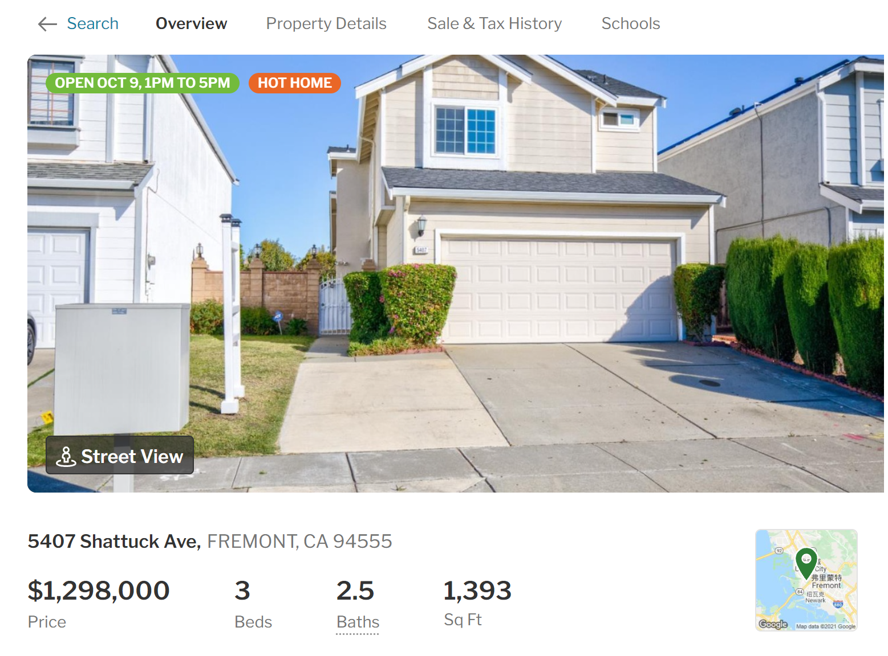
Which features have the most important weight on the housing prices (Regression model）

Slide 7
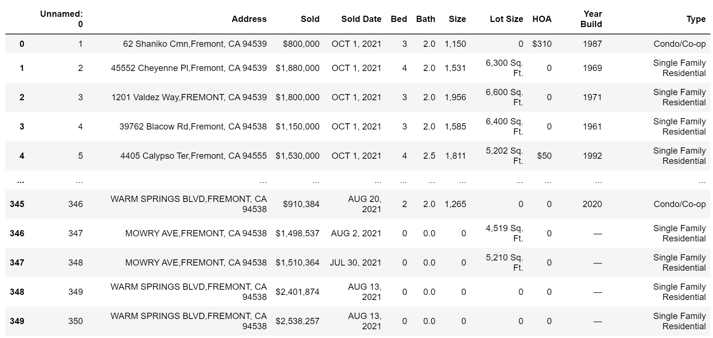

Slide 8
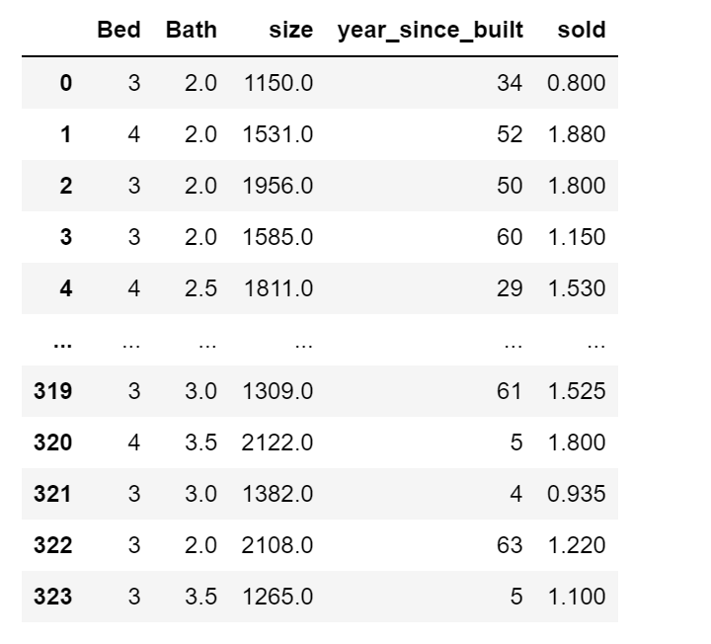

Slide 9
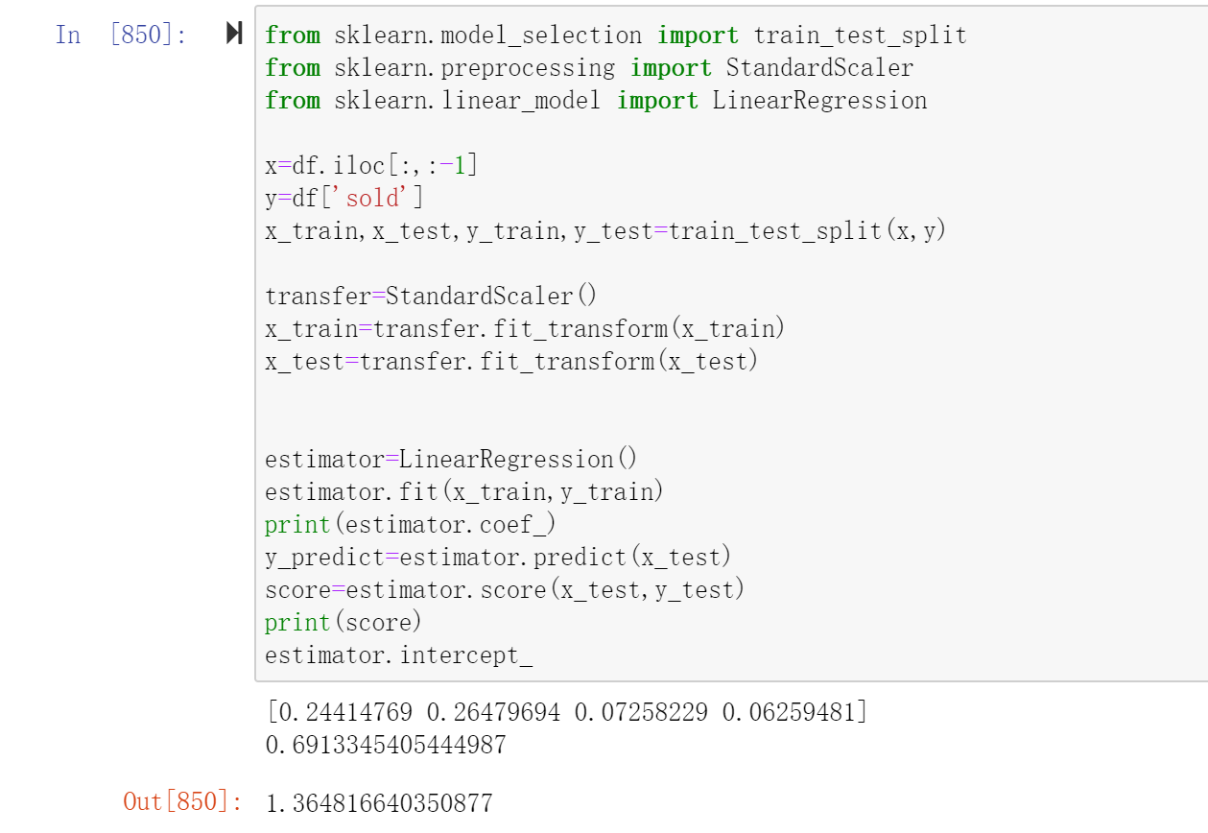

Slide 10
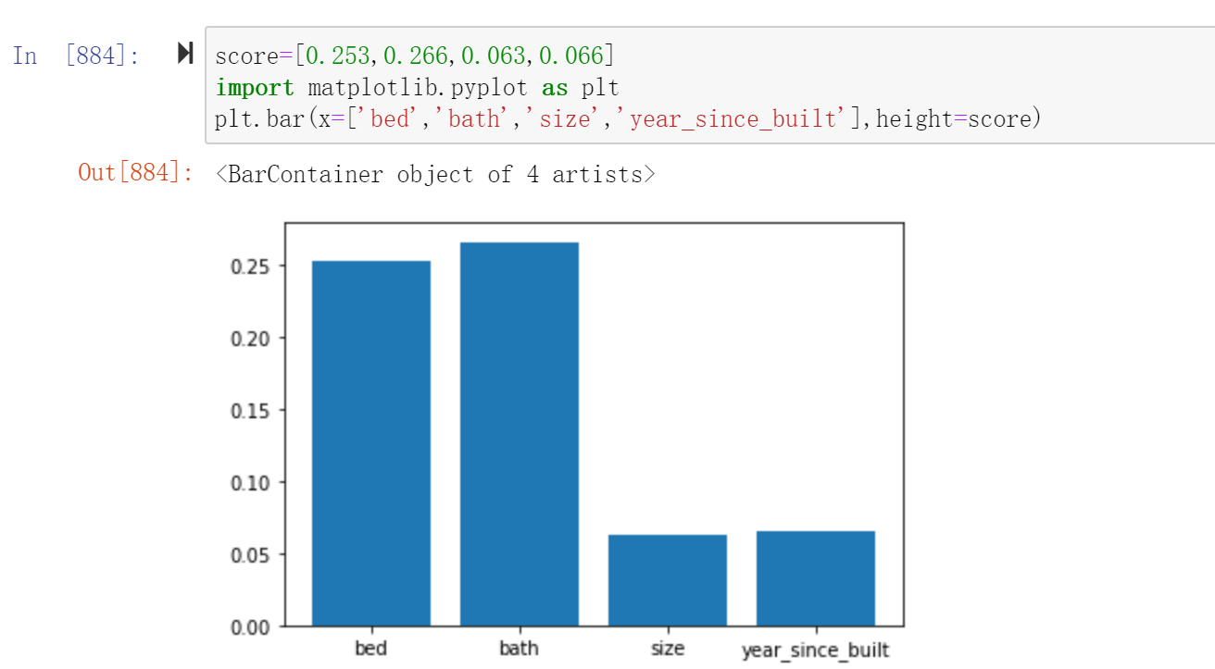

Slide 11

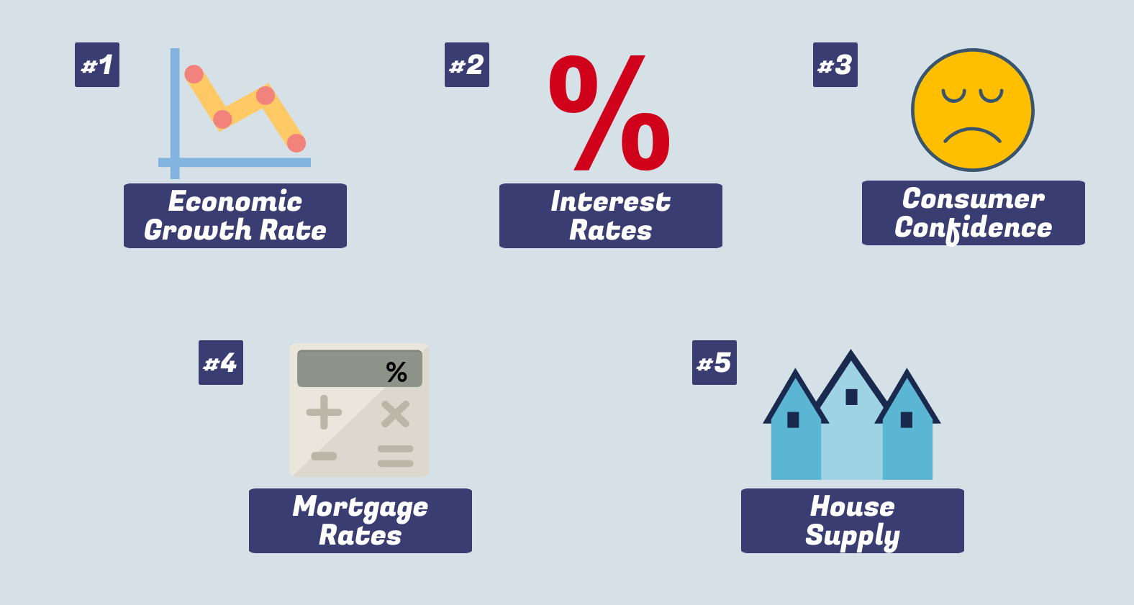

Slide 12
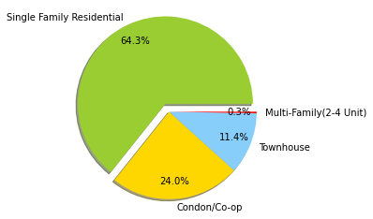
Which type of houses was the most popular in Fremont in the past three years?
Single Family Houses was the most popular type of home in Fremont, CA in the past 3 years.
2018.10-2021.09

Slide 13
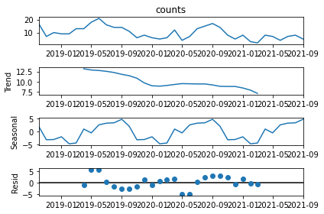
Using time series -autoARIMA module to predict the number of houses that will be sold in the next 3 months
Time Series components:
downward trend
seasonality
residual

Slide 14
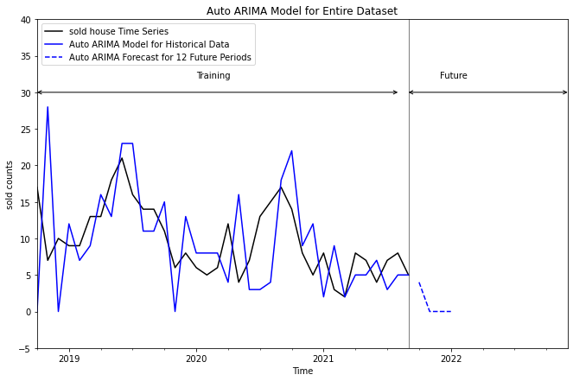
Accuracy measures:
Root Mean Squared Error (RMSE) : 6.9462. Relatively small.
Use auto_arima()function to fit ARIMA model for training data to identify the optimal values of all ARIMA parameters
Best model: ARIMA(2,2,0)(1,1,0)[12]
Plot historical data, auto ARIMA model predictions for historical data and forecast for 2021/10-2022/1.

Slide 15
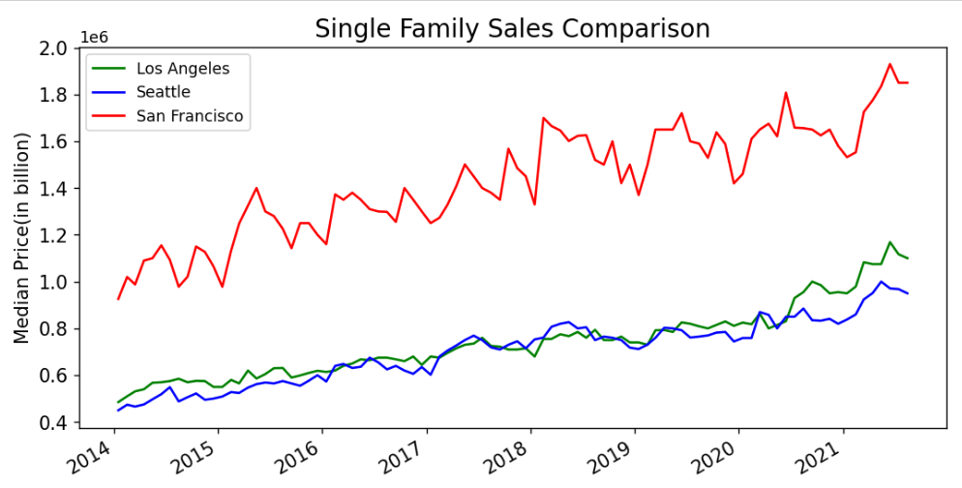
What is the housing price comparing between Los Angeles,Seattle and San Francisco?
- San Francisco has the highest sales price amount all these 3 cities
- Sales price of Los Angeles and Seattle are very very similar to each
- All 3 cities have upward linear trend of the sales price of single family

Slide 16
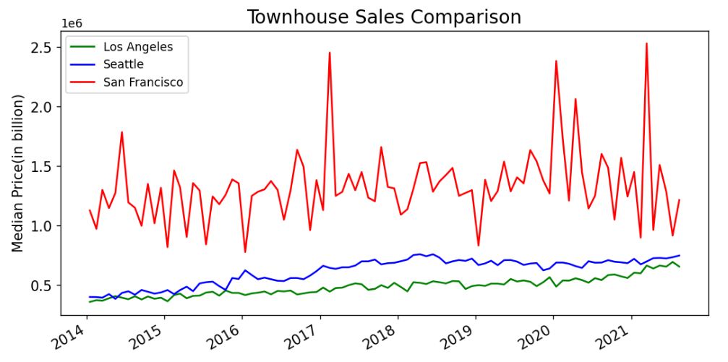
San Francisco still has highest sale price and Los Angeles is the lowest one
Townhouse price in San Francisco constantly changes during the past 7 years, while price in Los Angeles and Seattle is much more stable.

Slide 17
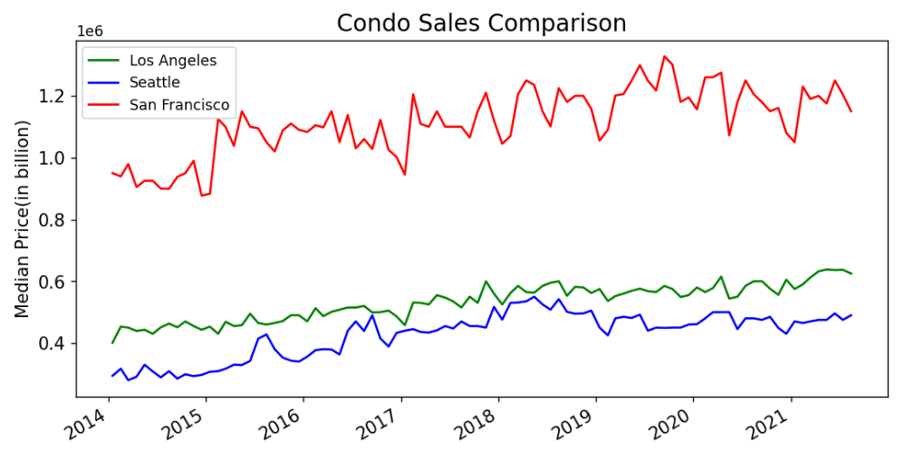
- Not surprisingly, San Francisco is the one has highest sales price
- Unlike the townhouse graph, this time Seattle has the lowest sale price of condo
- Overall, the change of condo price is between 0.1~0.3 billion, very stable than other two types of houses.
Conclusion: from the investment aspect, the single-family house is the definitely the one worth to put in the money and townhouse might be more risky, and condo is very stable, not a type for investment.

Slide 18
Appreciation Ratio
San Jose, Los Angeles, Seattle, New York City

Slide 19
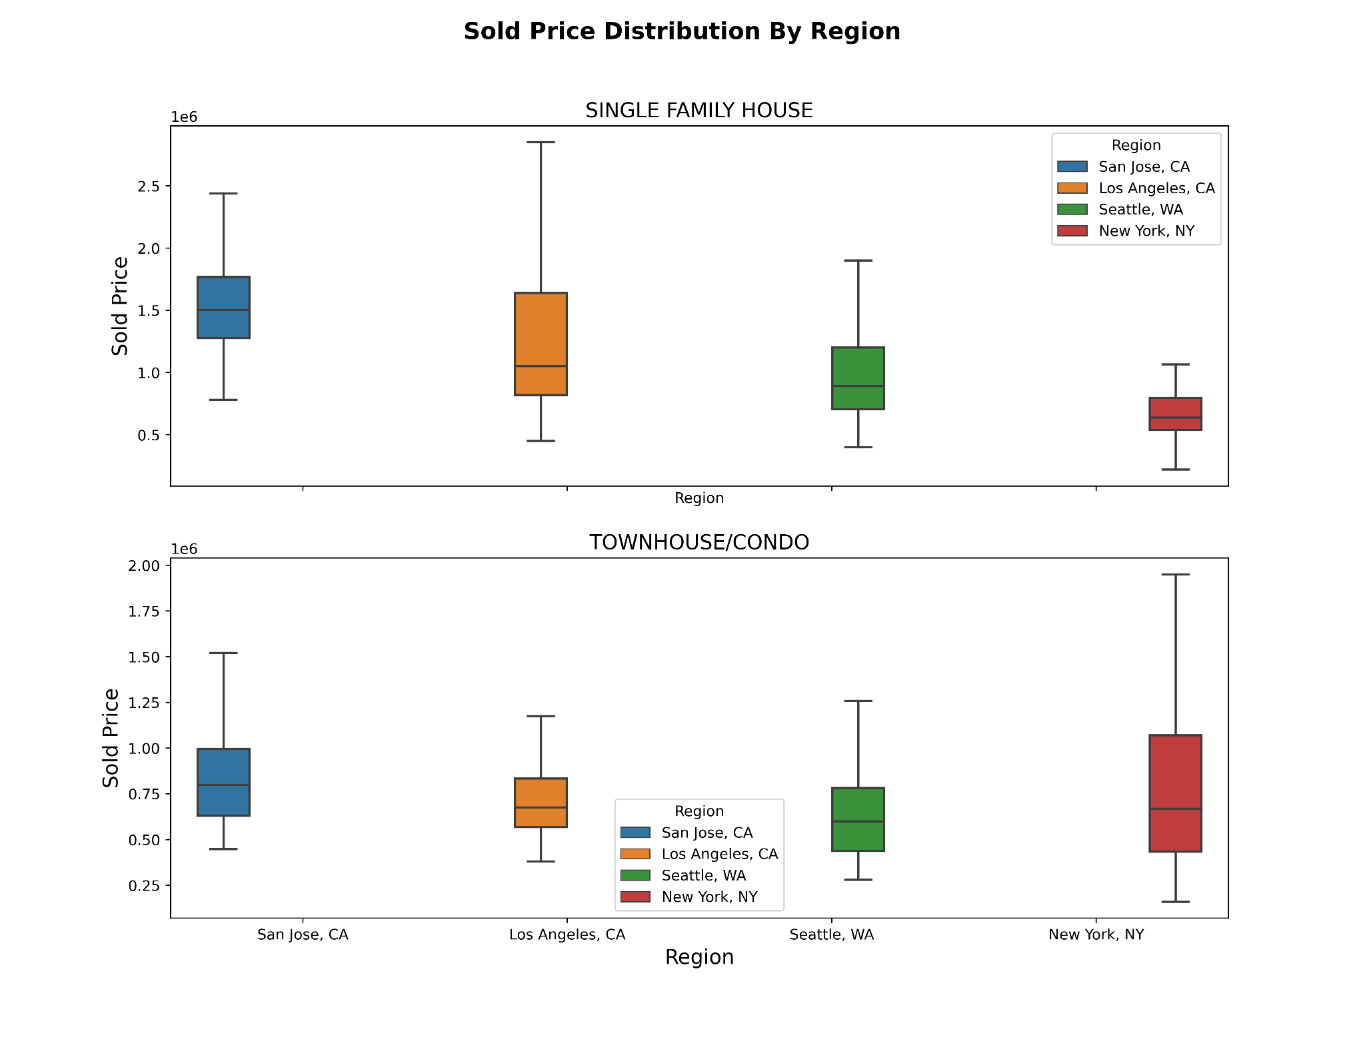
Sold Price Distribution July-September 2021
San Jose: Highest price distribution
Los Angeles: Wider price range in Single Family House
Los Angeles: Outliers are dropped
New York: Wider price range in Condo and Townhouse
New York: Single family house samples may not significant

Slide 20
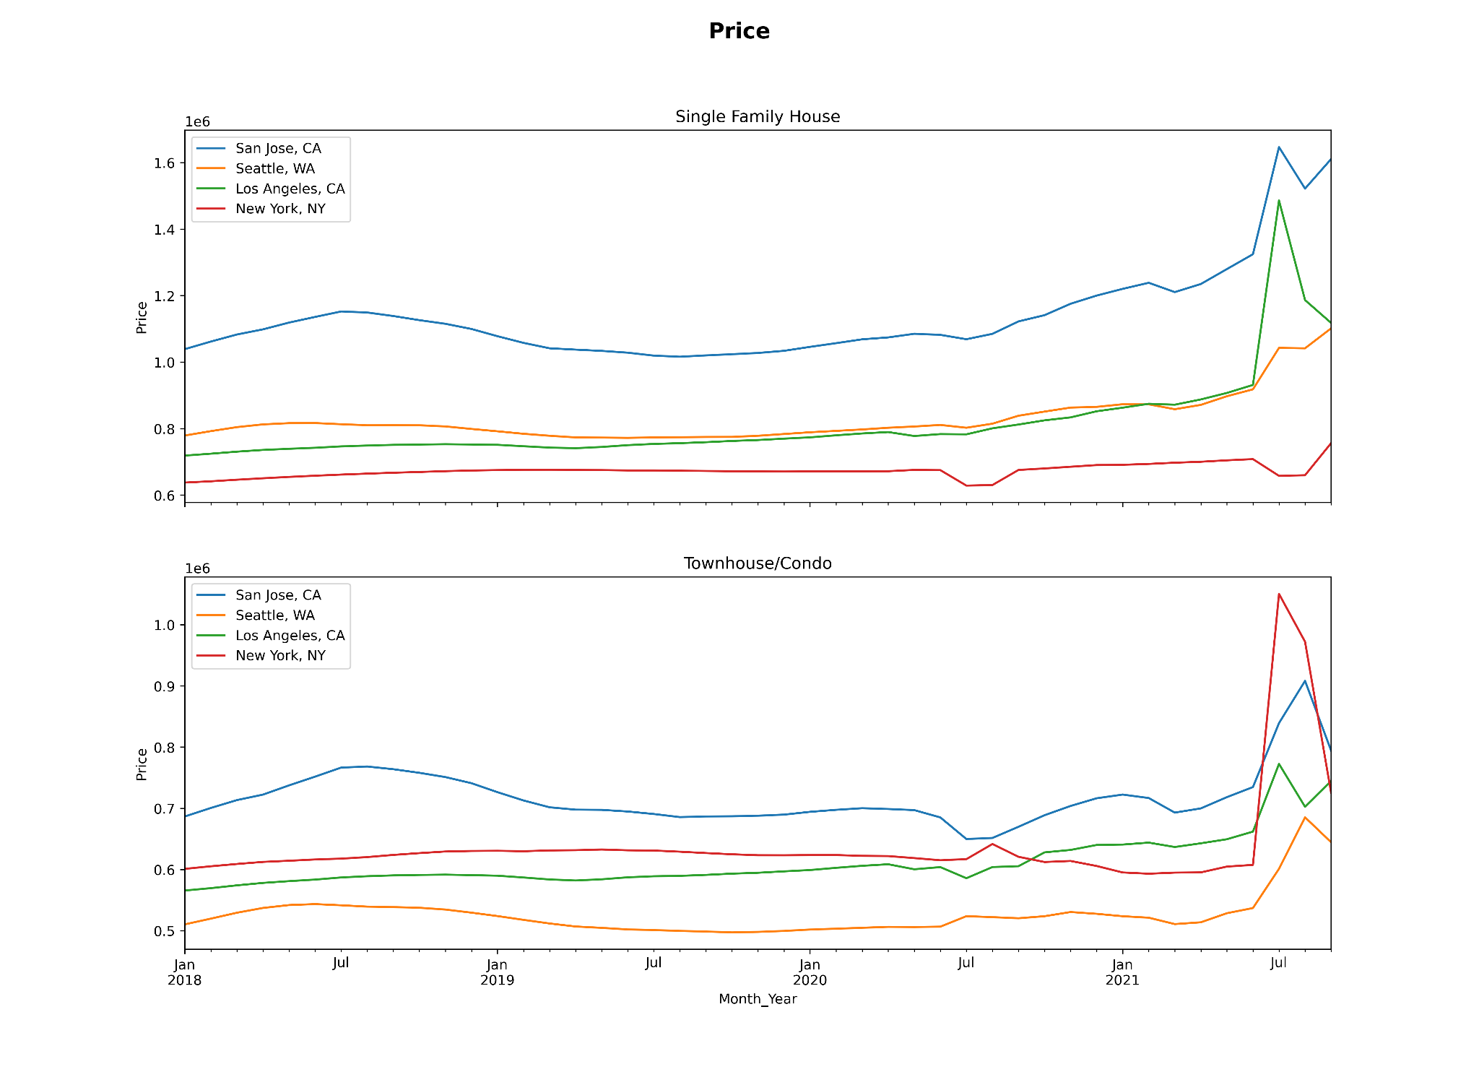
House Price 2018-Now
New York: price deep down during the early stage of Pandemic
San Jose: House price dropped during 2019 due to economic recession
House price on all types has a jump after July 2021

Slide 21
Calculation
Formula:
Change in Value = Current Year House Value - Previous Year House Value
Appreciation Ratio = Change in Value/Previous Year House Value
Dataset:
2019 vs. 2018, 2020 vs. 2019, 2019 vs. 2018 Q3
Vaccine is widely introduced around the nation
Gradually open and Shelter in place order was lift

Slide 22
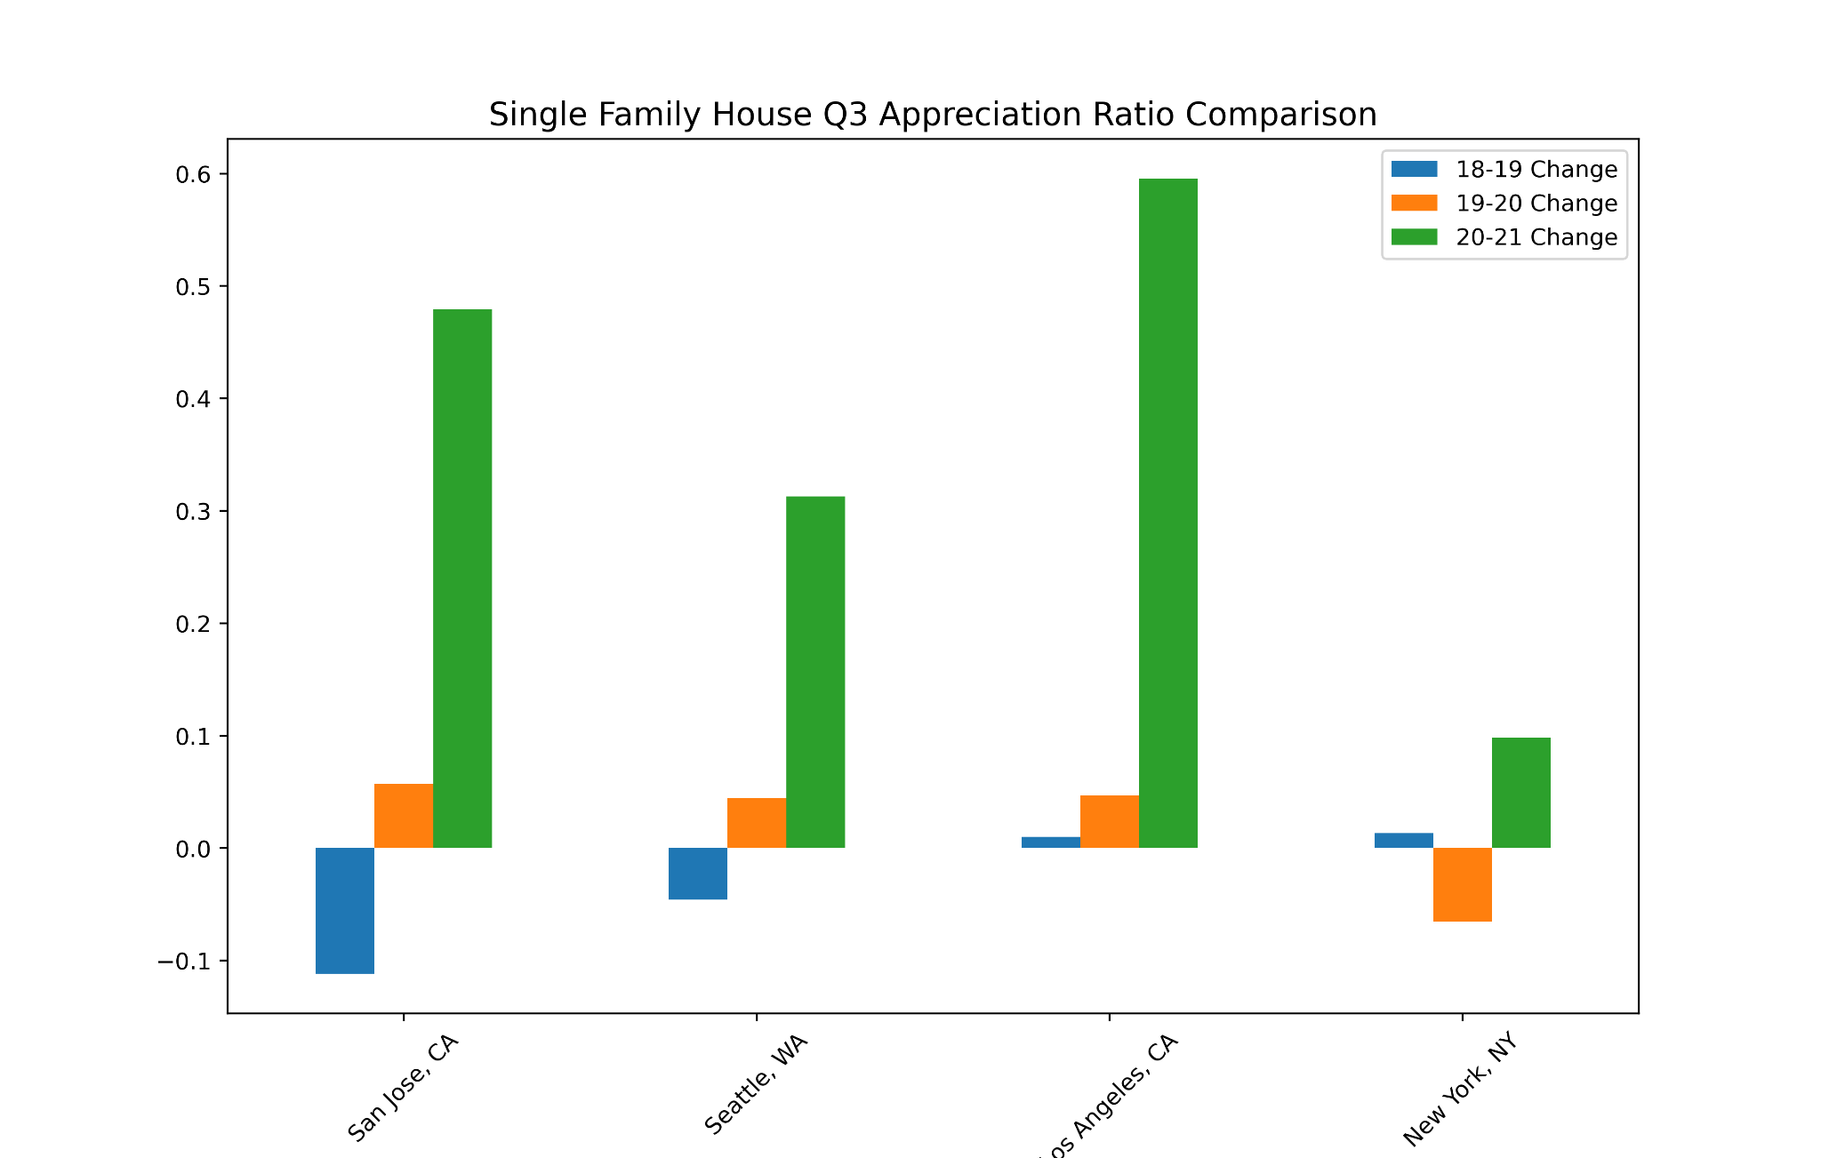
Single Family House Q3 Appreciation Ratio
National: 3.9%
All four cities : bigger than national in 2020 and 2021
San Jose: pandemic has minimal impact, big jump on appreciation value from 2019 to 2020. The appreciation value is still high in 2021.
Los Angeles/Seattle: Big jump on appreciation value in 2021 (relatively low living cost and more job opportunity could be the reason to attract more people to move in )

Slide 23
API
East Zone and South Zone

Slide 24
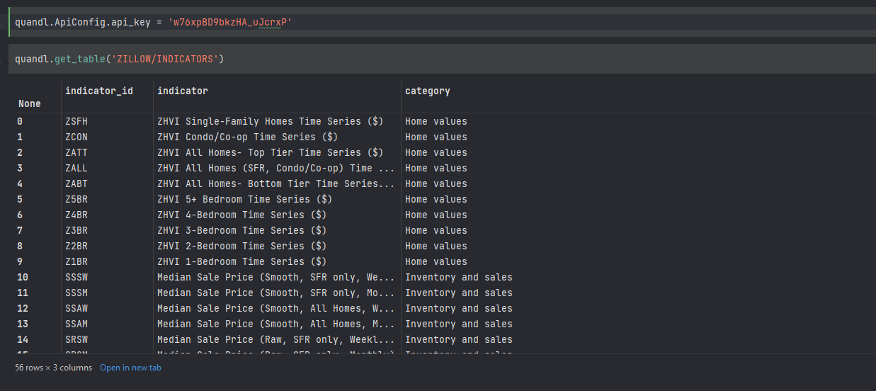
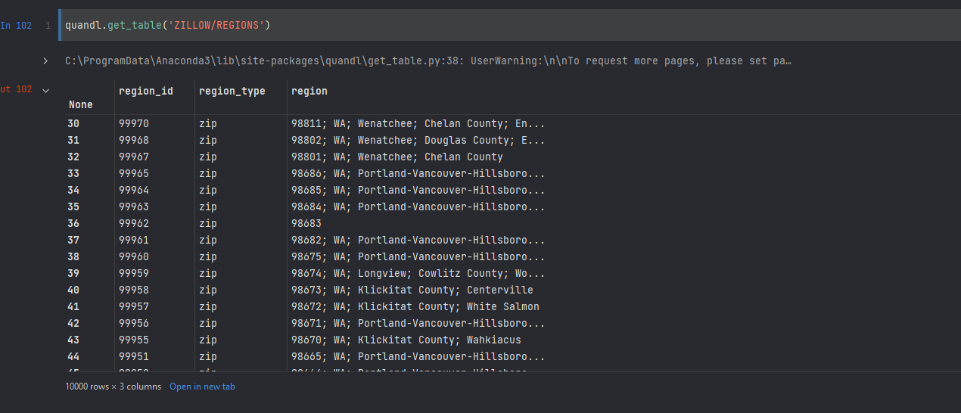
Zillow Tables from using Nasdaq(Quandl)API
We have used the Quandl library to access the Zillow Housing Data using quandl functions.
quandl.get_table()

Slide 25
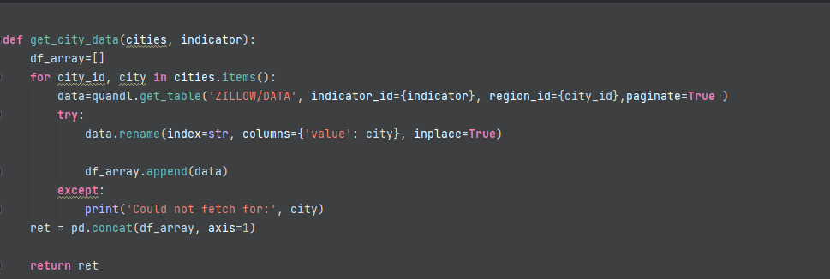
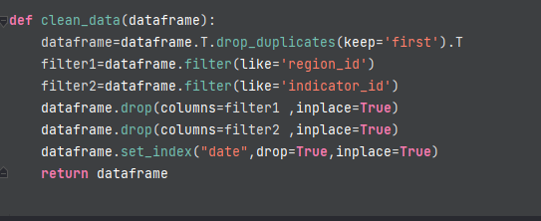
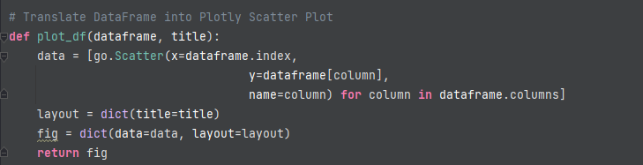
Methods to access the data, Clean the data,
and finally, Visualize the data using Plotly

Slide 26
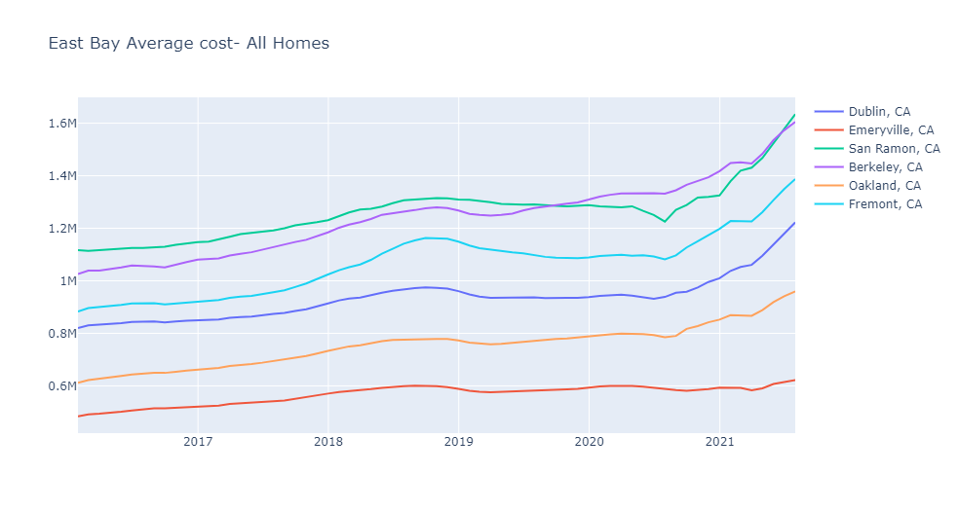
Average Home cost(All kinds)
in the cities of East Bay

Slide 27
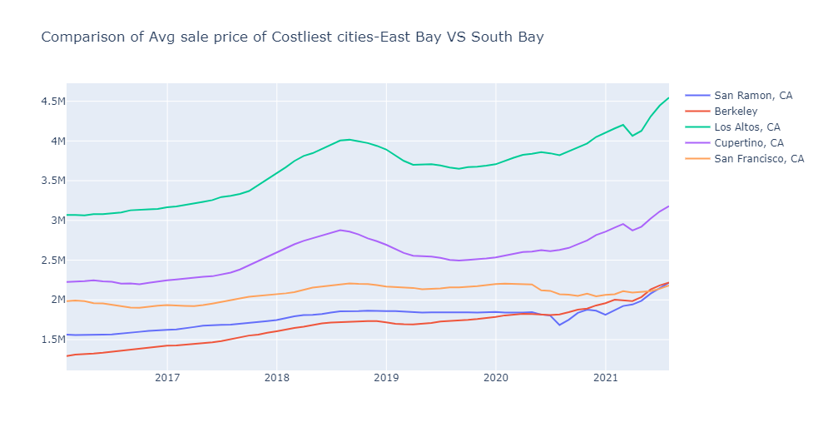
Comparison of top 2 cities in East Bay Vs Top 2 in South Bay vs San Francisco
We can see a huge bump in house cost between late 2017 to early 2019.
Also, the effect of COVID19 can be easily seen in the San Francisco line.

Slide 28
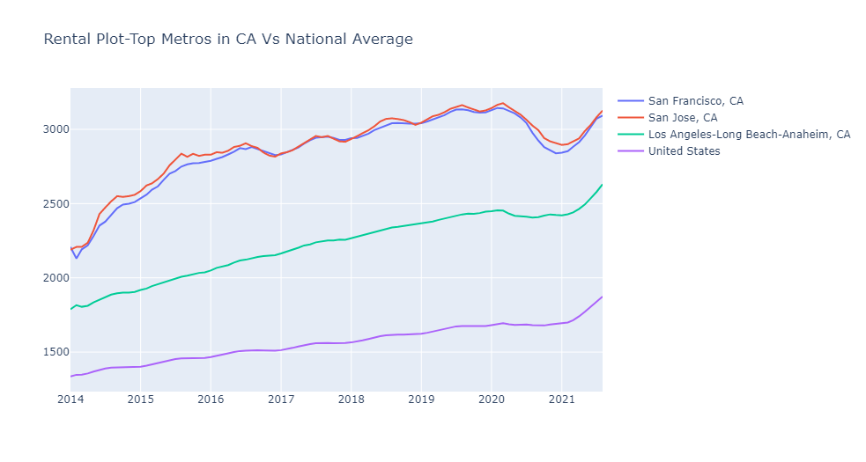
Comparison- Rental price in the Top metros of CA Vs the National Average
looking at the data, we can confirm that the renal prices usually drop between Nov & March with few variations.
there was a huge exodus from these top metros as a result of COVID19.
though, where most of them moved would be yet another question to analyse

Slide 29
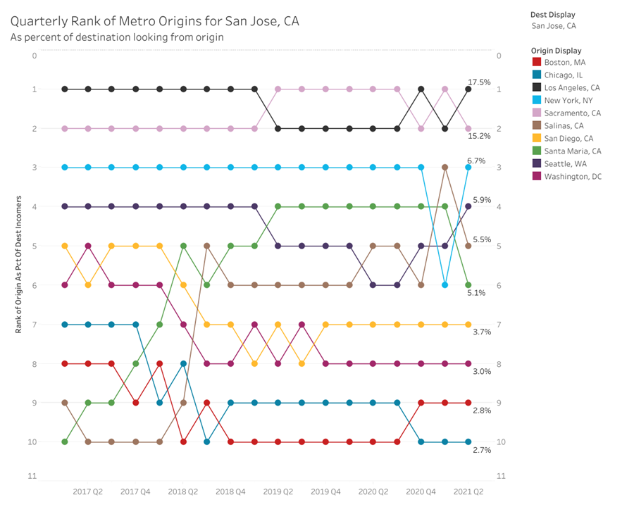
San Jose -Immigration 2017 -2018

Slide 30
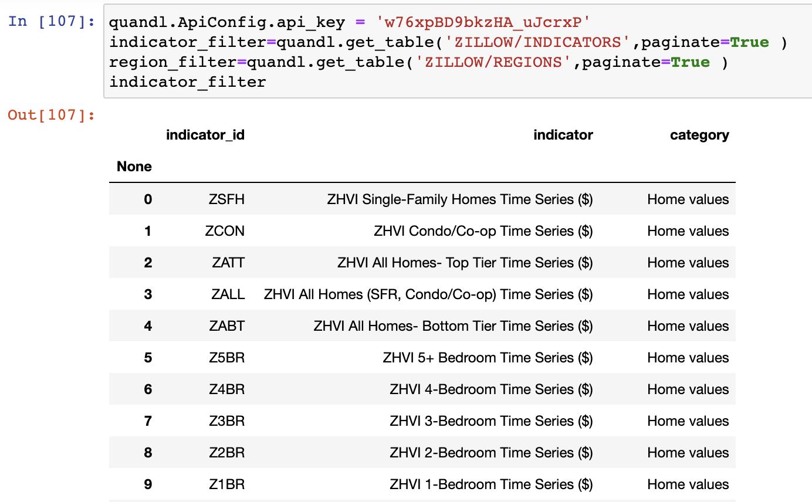
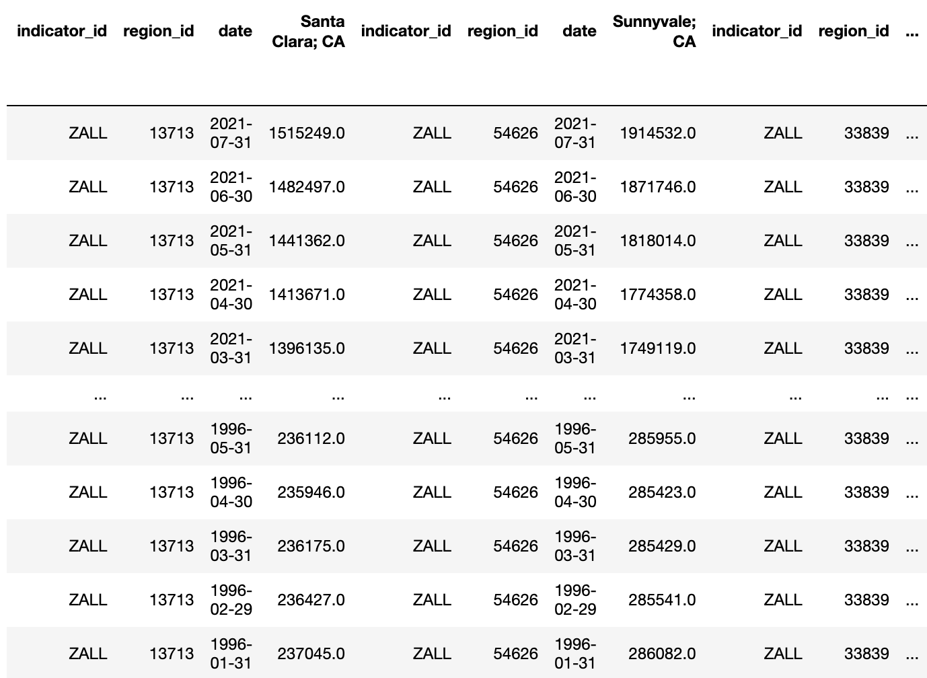
Sample Output of API Data

Slide 31
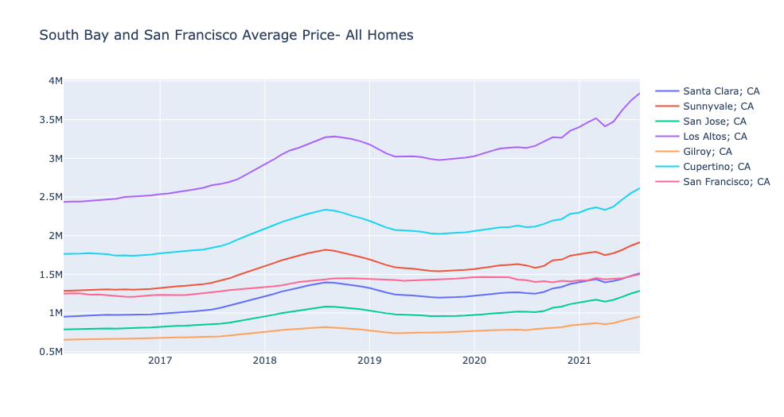
Comparison of Average price (All Homes) of cities in South Bay and San Francisco
Los Altos, Cupertino and Sunnyvale have higher prices compared to San Francisco.
Overall the cities follow the same trend over the years.
There is a exponential hike in price during 2018-2019 reason being rise in Mortgage rate.
Mortgage rate rose from 3.99 in 2017 to 4.54 in 2018.

Slide 32
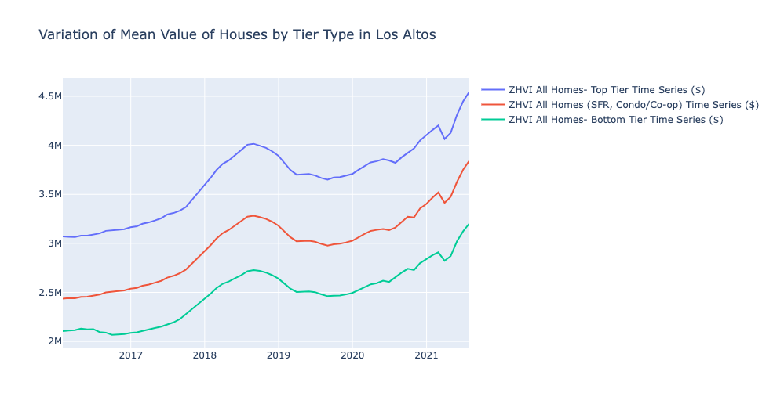
How do the home values change with time across the tiers(Los Altos and San Francisco)
Prices have increased during covid-19 with a steep dip Around March-April of 2021.
After a dip in 2021, the prices again shows an increasing trend.
Overall, the prices of Top Tier houses in Los Altos are comparatively high than those in San Francisco.

Slide 33
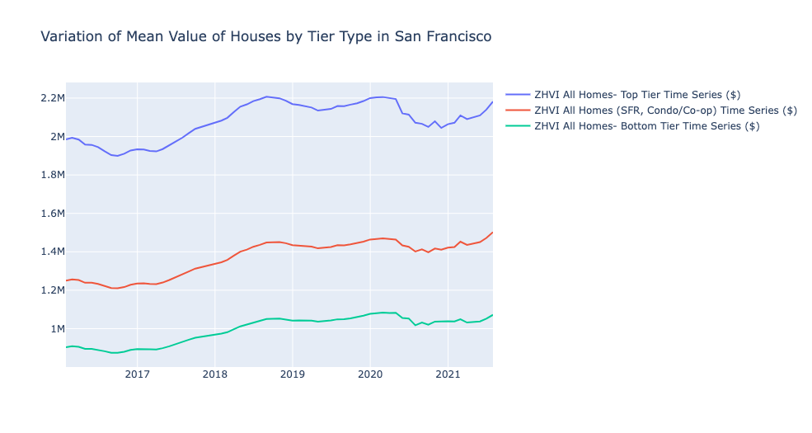
Continuation to previous slide:
The price of Top tier homes in SF are quite high compared to those in bottom tier(almost 2 times the bottom tier price)
SF showed a decrease in price during covid across all the tiers.
Top tier category have shown higher dip in price during covid, reason being the higher rent rates.

Slide 34
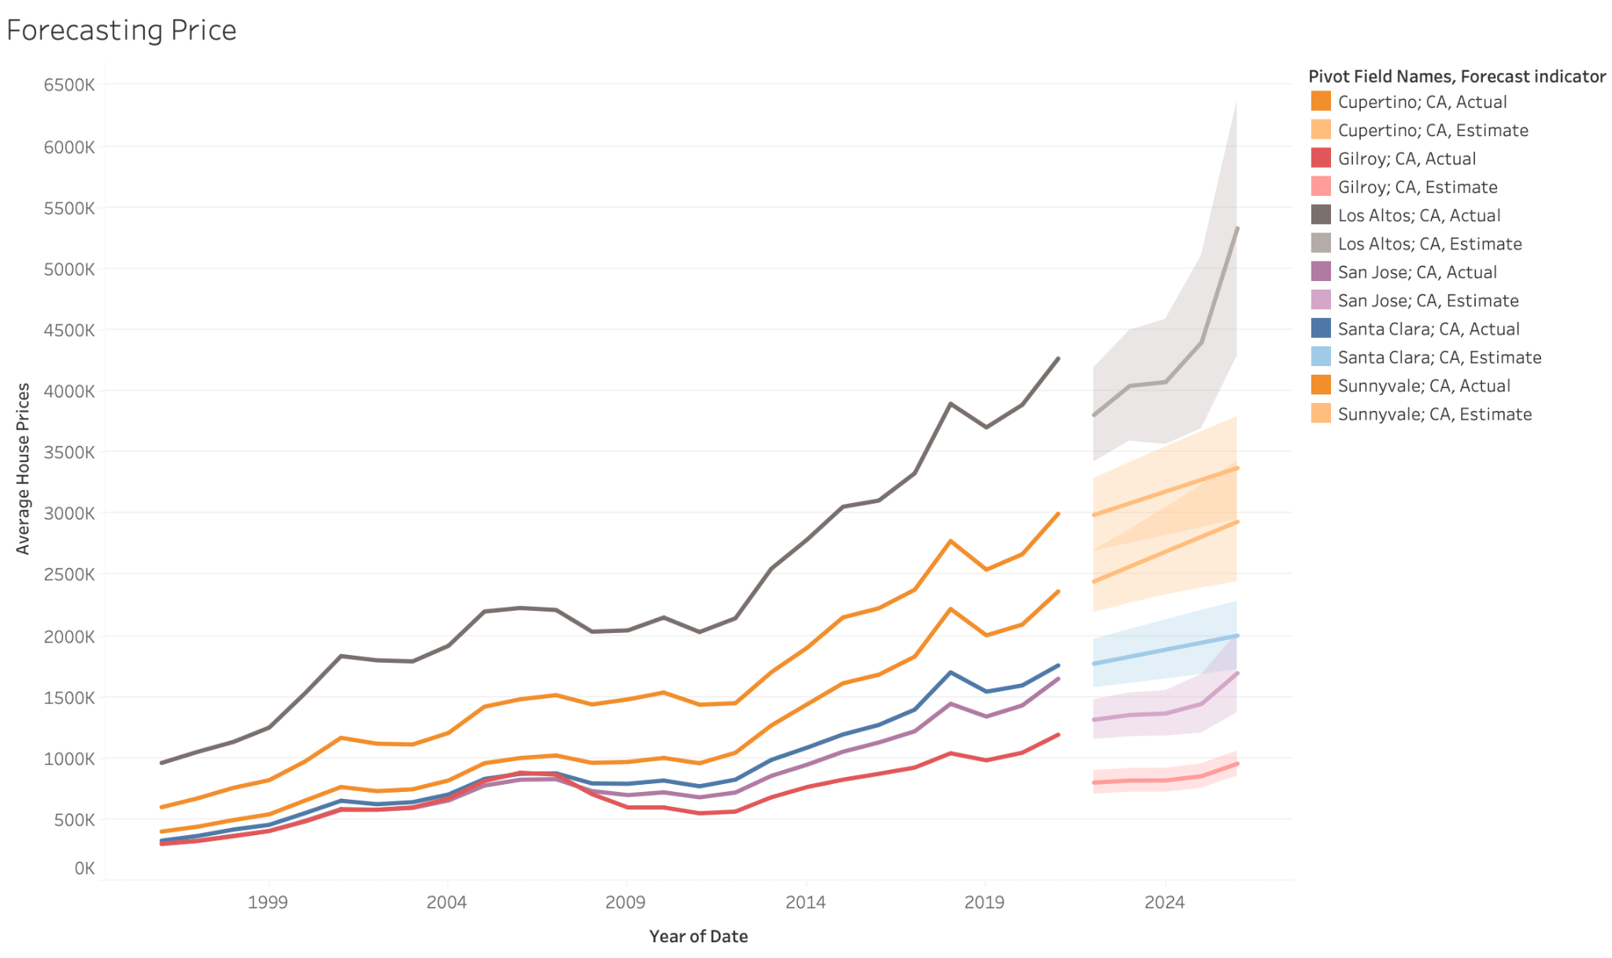
Forecasting the price for cities in South Bay
Forecasted data for 5 years using Tableau inbuilt forecast function.
Los Altos will expect a drastic increase in house price in coming 5 years.
Other cities are also showing a forecast of increase in prices in the coming future.
To conclude anyone who is planning to make investments in South Bay Area, probably its right time to do now as Mortgage rate is real time low varying around 2.5-3.2% and as per the forecast, the prices will tend to rise further in the coming future.

Slide 35
Thank you!
Questions?

